Slide 1
Fine-grained image recognition meth is not clearly understand

Slide 2
Deep learning for fine-grained image analysis: A survey
Xiu-Shen Wei1 , Jianxin Wu2 , Quan Cui1,3
Notes:
第一页

Slide 3
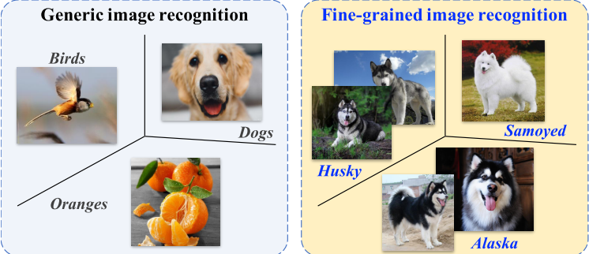
Abstract
Giving a review of FGVC techniques based on deeplearning
(backgrounds,banchmark datasets,methods,applications)。
Discussing the challenges and issues，and identify feature direction。
Notes:
第二页

Slide 4
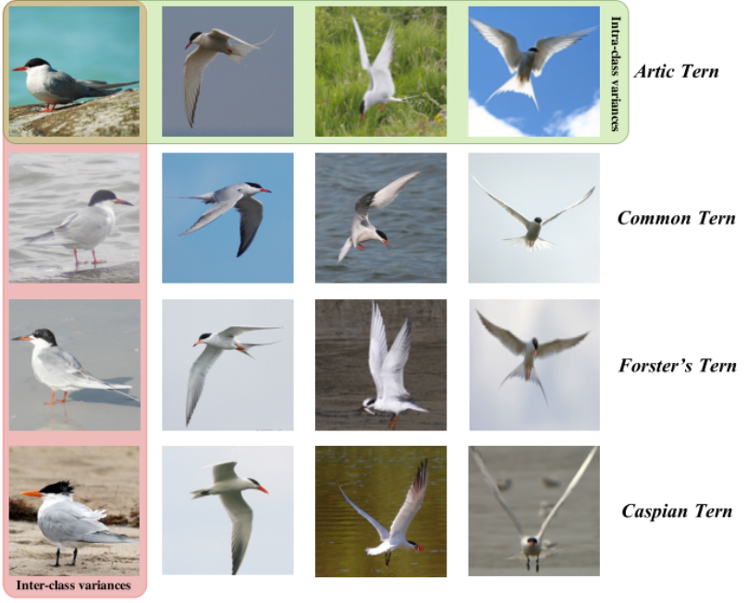
Background: problem and main challenges
Large intra-class
Variation。
Small inter-class
Variation。

Slide 5
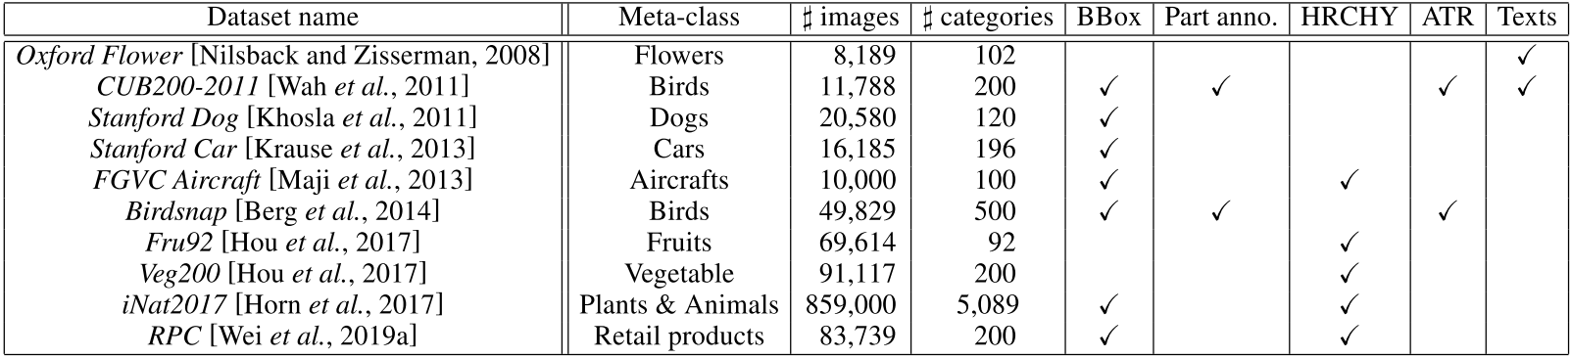
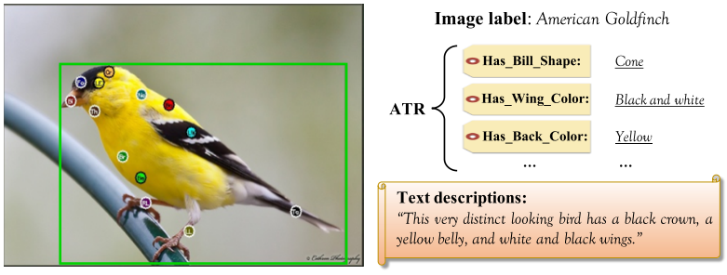
Benchmark datasets
Part anno：key part localizations。
HRCHY: hierarchical labels。
ATR：wing color，gender。
Texts

Slide 6
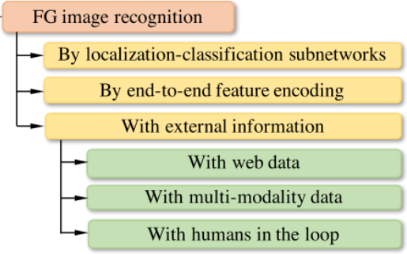
Fine-grained image recognition
LCS：

Slide 7
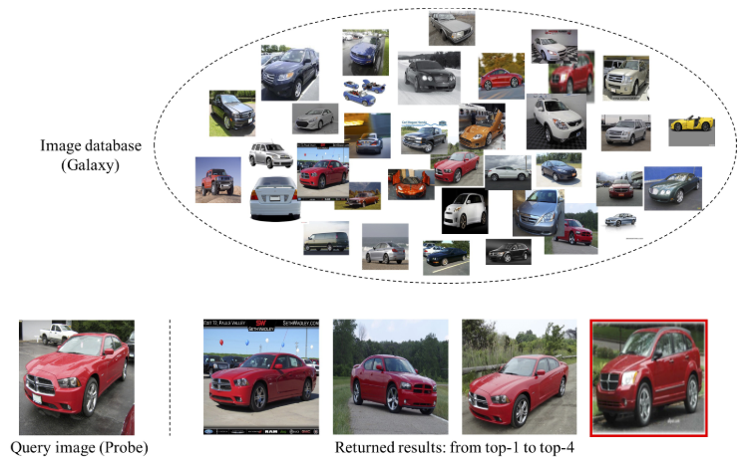
Fine-grained image retrieval
a

Slide 8
Conclusion
G produces the attention map via an attentive-recurrent network and applies this map along with the input image to generate a raindrop-free image through a contextual autoencoder。
Our novelty lies on the use of the attention map in both generative and discriminative network。

